Slide 1
Multithreading

Slide 2
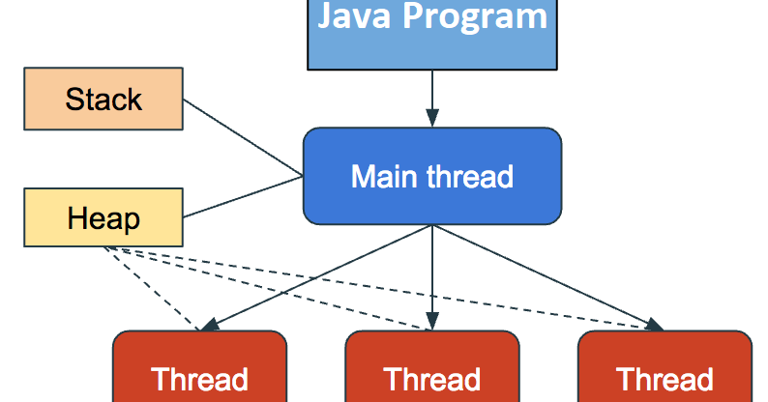
Java Multithreading

Slide 3
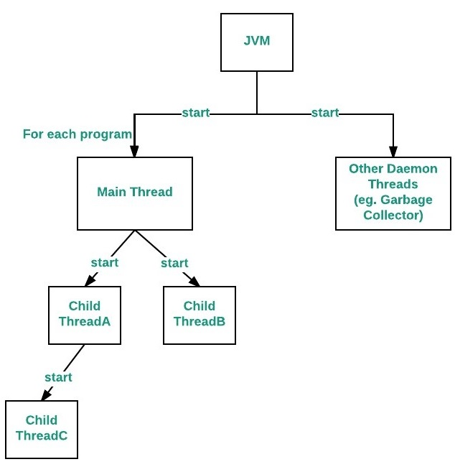
Java as a MultiThreading

Slide 4
MultiThreading Examples
Web Browsers - A web browser can download any number of files and web pages (multiple tabs) at the same time and still lets you continue browsing. If a particular web page cannot be downloaded, that is not going to stop the web browser from downloading other web pages.
Web Servers - A threaded web server handles each request with a new thread. There is a thread pool and every time a new request comes in, it is assigned to a thread from the thread pool.
Computer Games - You have various objects like cars, humans, birds which are implemented as separate threads. Also playing the background music at the same time as playing the game is an example of multithreading.
Text Editors - When you are typing in an editor, spell-checking, formatting of text and saving the text are done concurrently by multiple threads. The same applies for Word processors also.

Slide 5
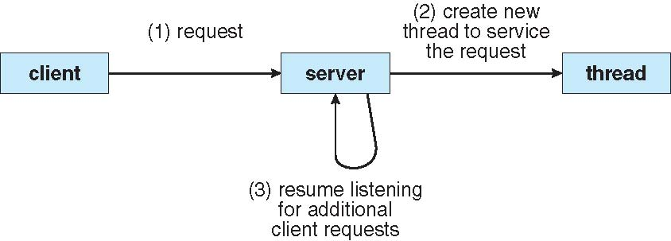
Multithreaded Server Architecture

Slide 6
Multithreading in Java
In Java, Multithreading refers to a process of executing two or more threads for maximum utilization of the CPU.
A thread in Java is a lightweight process requiring fewer resources to create and share the process resources.
Threads use a shared memory area. They don't allocate separate memory area so saves memory, and context-switching between the threads takes less time than process.
Java Multithreading is mostly used in games, animation, etc.

Slide 7
Thread
A thread is a lightweight sub process, the smallest unit of processing. It is a separate path of execution.
Threads are independent. If there occurs exception in one thread, it doesn't affect other threads. It uses a shared memory area.

Slide 8
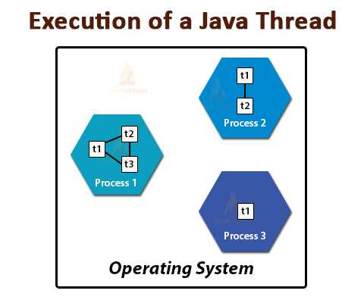
Multiple threads can be a part of single process
As shown in the figure, a thread is executed inside the process. There is context-switching between the threads. There can be multiple processes inside the OS, and one process can have multiple threads.

Slide 9
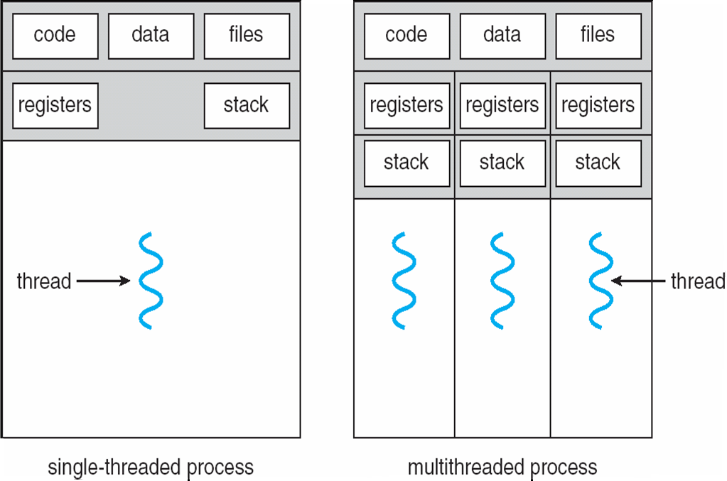
Single and Multithreaded Processes

Slide 10
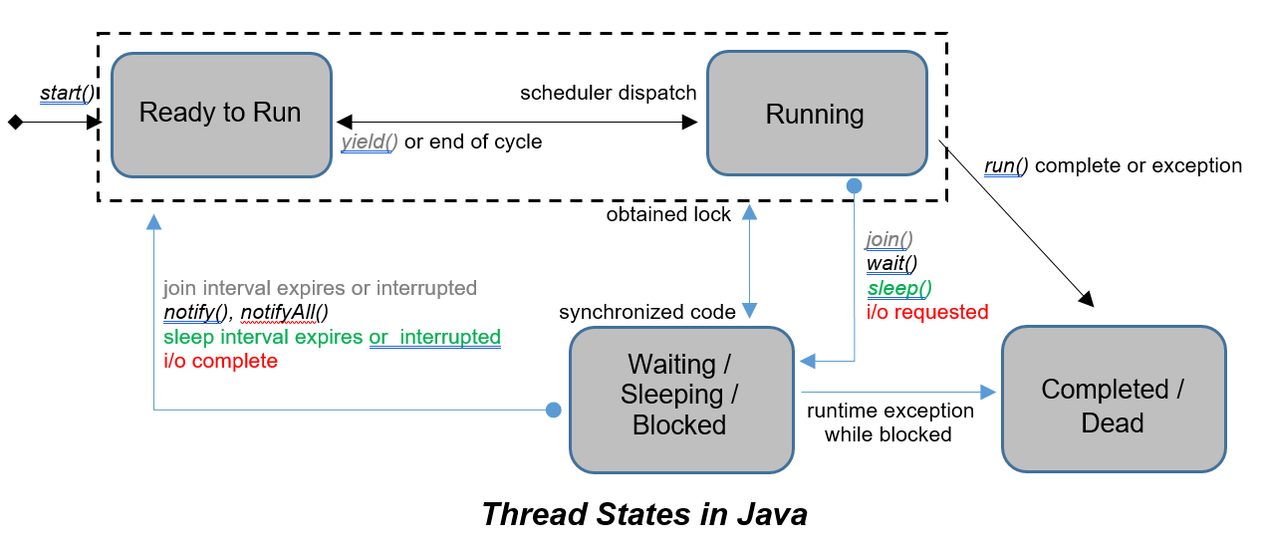
Thread LifeCycle

Slide 11
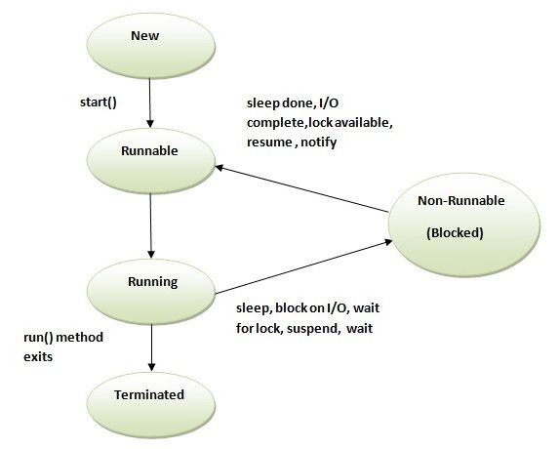
Thread Lifecycle States

Slide 12
Java Thread Life Cycle
New: When instance of thread is created using new operator it is in new state, but the start() method has not been invoked on the thread yet, thread is not eligible to run yet.
Runnable: When start() method is called on thread it enters runnable state. As soon as Thread enters runnable state it is eligible to run, but not running. (Thread scheduler has not scheduled the Thread execution yet.)
Running: Thread scheduler selects thread to go from runnable to running state. In running state Thread starts executing by entering run() method.

Slide 13
Java Thread Life Cycle
Waiting/Blocked/sleeping: In this state a thread is not eligible to run.
By calling wait() method thread go from running to waiting state. In waiting state it will wait for other threads to release object monitor/lock. Once notify() or notifyAll() method is called object monitor/lock becomes available and thread can again return to runnable state.
By calling sleep() method thread go from running to sleeping state. In sleeping state it will wait for sleep time to get over. Once specified sleep time is up thread can again return to runnable state.
Suspend() method can be used to put thread in waiting state and resume() method is the only way which could put thread in runnable state.
Terminated (Dead): A thread is considered dead when its run() method completes. Once thread is dead it cannot be started again doing so will throw runtimeException i.e. IllegalThreadStateException. destroy() method puts thread directly into dead state.

Slide 14
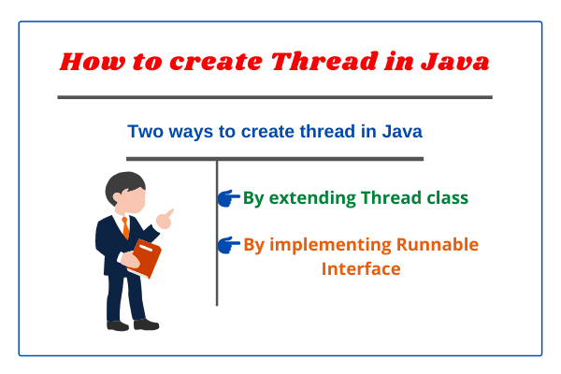

Slide 15
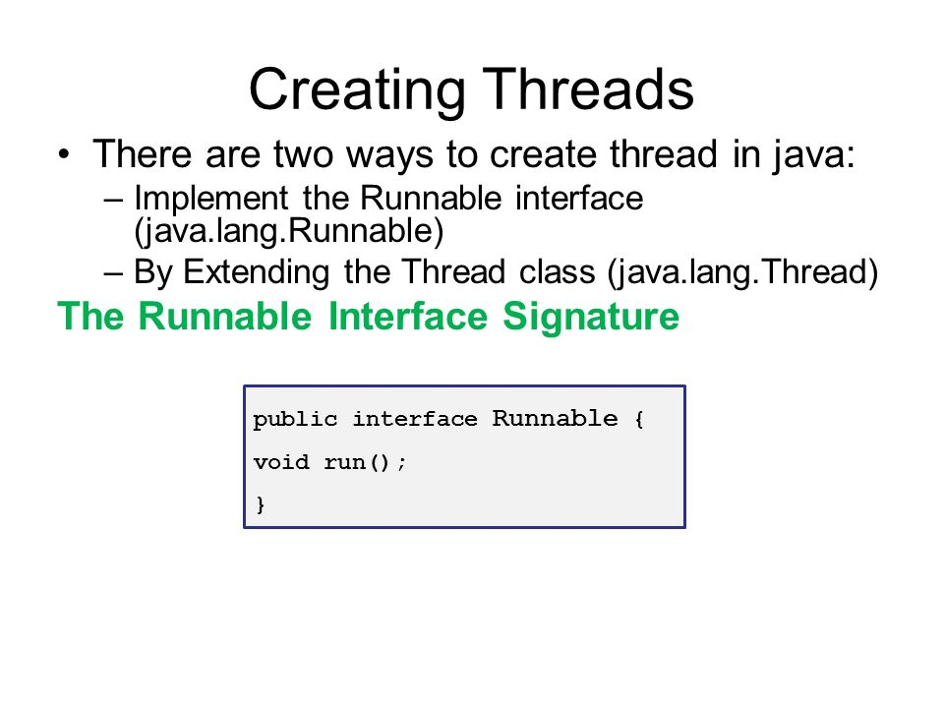

Slide 16
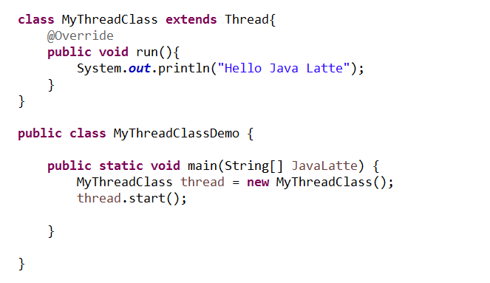
By extending Thread Class

Slide 17
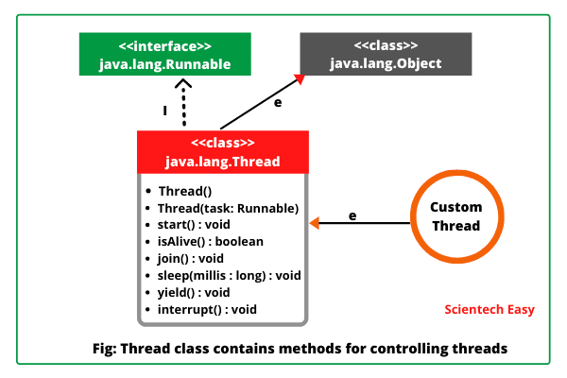

Slide 18
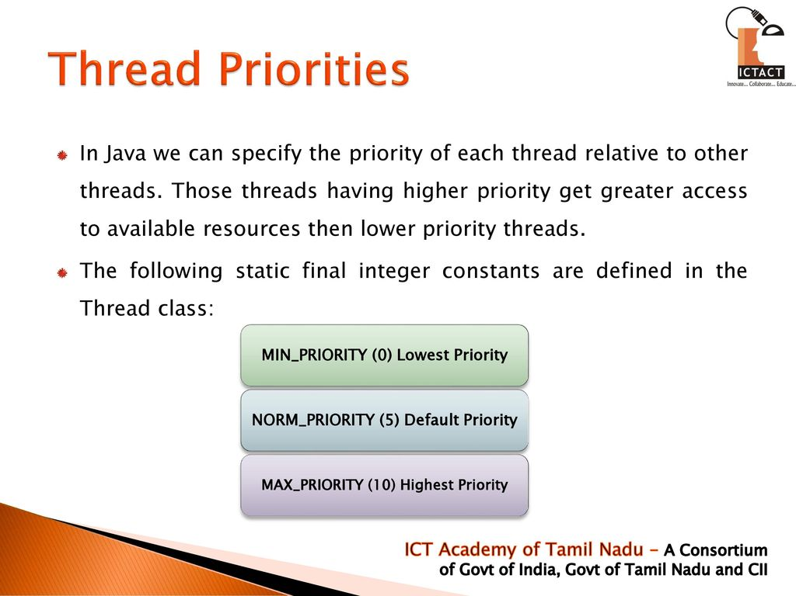

Slide 19
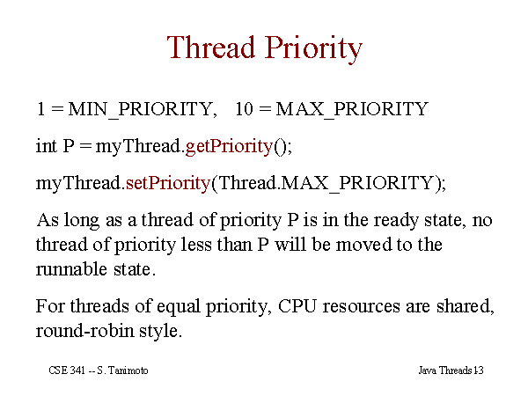

Slide 20
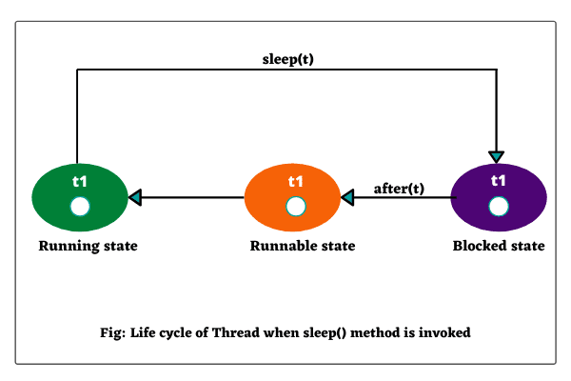
Thread sleep method

Slide 21
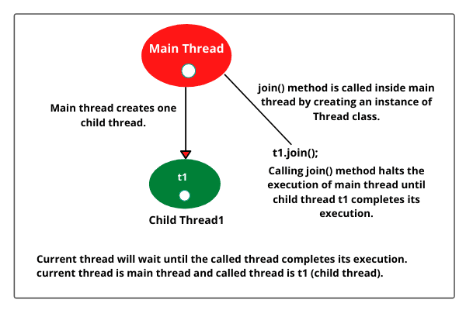
Thread join method.

Slide 22
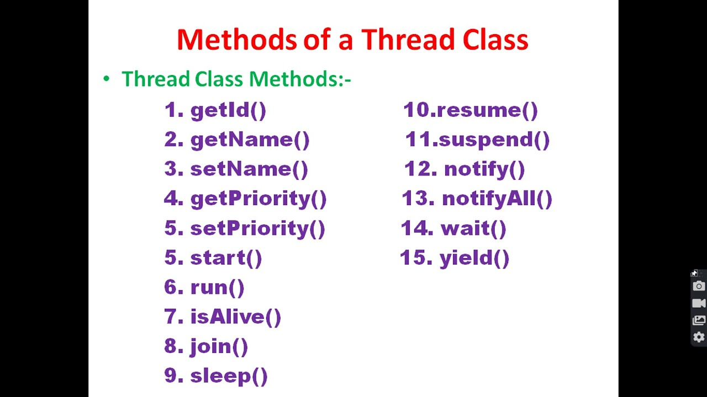

Slide 23
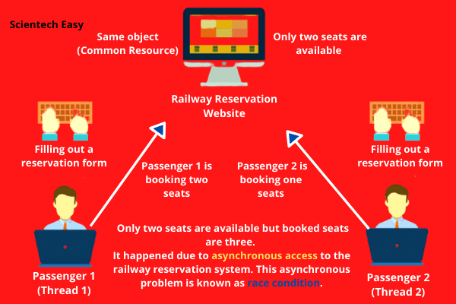
Thread Race Condition due to shared resource(Critical Section) accessed non atomic way

Slide 24
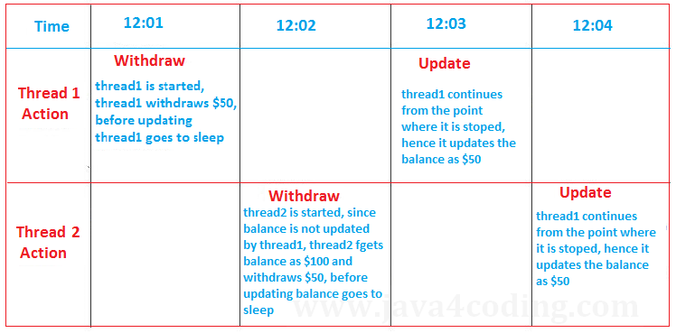
Thread Race Condition due to shared resource(Critical Section) accessed non atomic

Slide 25
Critical Section
Critical Section refers to the segment of code or the program which tries to access or modify the value of the variables in a shared resource.
a critical section is a group of instructions/statements or region of code that need to be executed atomically, such as accessing a resource (file, input or output port, global data, etc.). In concurrent programming, if one thread tries to change the value of shared data at the same time as another thread tries to read the value (i.e. data race across threads), the result is unpredictable.

Slide 26
Synchronization
The access to such shared variables (shared memory, shared files, shared port, etc…) is to be synchronized. Few programming languages have built-in support for synchronization.
Java provides synchronized keyword.

Slide 27
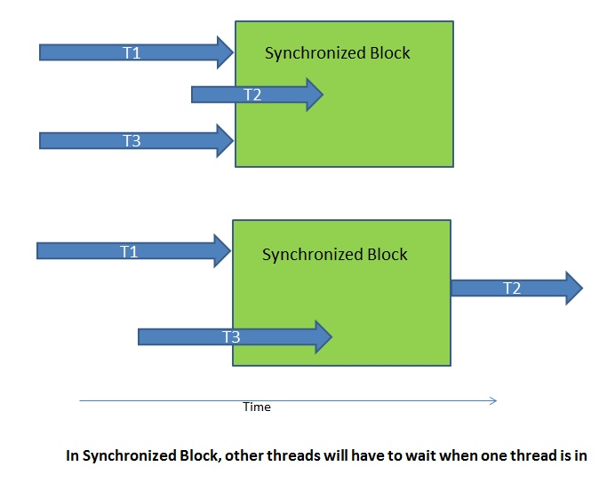
Synchronized Block

Slide 28
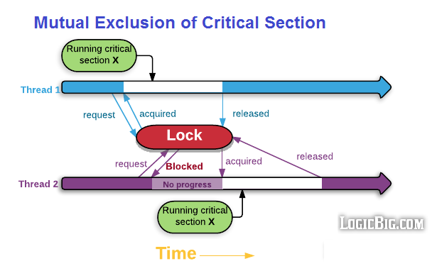
Access of Critical section at a time only single Thread allowed to get access

Slide 29
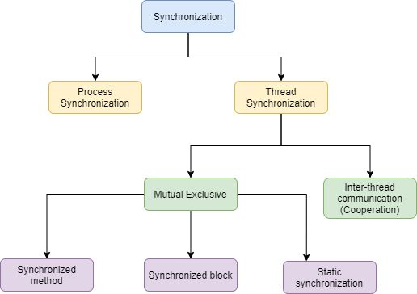
Synchronization

Slide 30
Inter Thread Communication API– wait()-notify()-notifyAll()
The threads can communicate with each other through wait(), notify() and notifyAll() methods in Java.
These are final methods defined in the Object class and can be called only from within a synchronized context.
The wait() method causes the current thread to wait until another thread invokes the notify() or notifyAll() methods for that object.
The notify() method wakes up a single thread that is waiting on that object’s monitor.
The notifyAll() method wakes up all threads that are waiting on that object’s monitor.
A thread waits on an object’s monitor by calling one of the wait() method. These methods can throw IllegalMonitorStateException if the current thread is not the owner of the object’s monitor.

Slide 31
Wait() vs wait(long timeout) method
Public final void wait() throws interrruptedException, IllegalMonitorStateException : When wait() is called on an object, the thread enters from running to waiting state. It waits for some other thread to call notify() or notifyAll() so that it can enter runnable state, a deadlock will be formed.
Public final void wait(long timeout) : In this method, When wait(1000) is called on an object, the thread enters from running to waiting state, even if notify() or notifyAll() is not called after timeout time has elapsed thread will go from waiting to runnable state.
Public final void notify()
Public final void notifyAll()

Slide 32
notify() method :
notify() : The notify() method is defined in the Object class, which is Java’s top-level class.
It’s used to wake up only one thread that’s waiting for an object, and that thread then begins execution. The thread class notify() method is used to wake up a single thread. If multiple threads are waiting for notification, and we use the notify() method, only one thread will receive the notification, and the others will have to wait for more. This method does not return any value.
It is used with the wait() method, in order to communicate between the threads as a thread that goes into waiting for state by wait() method, will be there until any other thread calls either notify() or notifyAll() method.

Slide 33
Notify() method
The synchronized keyword is used for exclusive accessing.
wait() instructs the calling thread to shut down the monitor and sleep until another thread enters the monitor and calls notify().
notify() wakes up the first thread that called wait() on the same object

Slide 34
Wait() vs sleep() method
No. | Key | Wait | Sleep
1 | Class | Wait() method belongs to Object class | Sleep() method belongs to Thread class
2 | Lock Release | Wait() releases the lock on an object | It does not release lock on an object
3 | Calling context | Wait() can be called on object itself | Sleep() can be called on thread
4. | Wake-up condition | until call notify(), notifyAll() from object | until at least time expire or call interrupt

Slide 35
Wait vs join() method
No. | Key | wait() | join()
1 | Declaration | wait() method is defined in Object class and hence the wait() method is declared in java.lang package. | join() method, on the other hand, is also defined in java.lang package but in Thread class.
2 | Usage | wait() method is primarily used for the inter-thread communication. | On the other hand join() is used for adding sequencing between multiple threads, one thread starts execution after first thread execution finished.
3 | Counter method | As wait() method is used to pause the current thread so its counter method is also provided in object class to resume the thread which is notify() and notifyAll(). | On the other hand we can not break the waiting imposed by join() method without unless or interruption the thread on which join is called has execution finished.
4 | Context | In order to call wait method we require synchronized block or method as if wait() method is called outside the synchronized context it will throw IllegalMonitorStateException. | On the other no such condition required for calling join() method and we can call join() method with and without synchronized context in Java..
5 | Lock Release | wait() releases the monitor or lock held on the object which wait is invoked on | On the other hand, calling join() method doesn't release any monitor or lock.

Slide 36
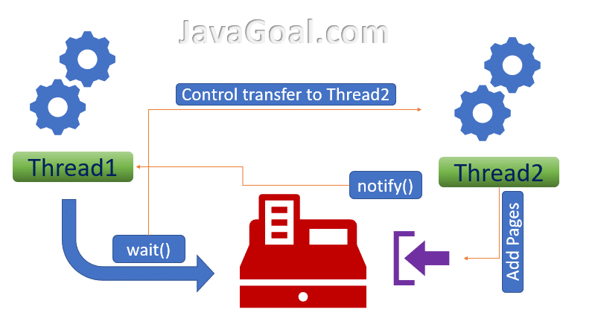
wait and notify method – Printing paper example – wait() and notify() In code has to be part of synchronized method/block

Slide 37
Producer – Consumer Problem
The Producer-Consumer problem is a classical multi-process synchronization problem, that is we are trying to achieve synchronization between more than one process.
There is one Producer in the producer-consumer problem, Producer is producing some items, whereas there is one Consumer that is consuming the items produced by the Producer. The same memory buffer is shared by both producers and consumers which is of fixed-size.
The task of the Producer is to produce the item, put it into the memory buffer, and again start producing items. Whereas the task of the Consumer is to consume the item from the memory buffer.

Slide 38
problems occur in Producer-Consumer
The producer should produce data only when the buffer is not full. In case it is found that the buffer is full, the producer is not allowed to store any data into the memory buffer.
Data can only be consumed by the consumer if and only if the memory buffer is not empty. In case it is found that the buffer is empty, the consumer is not allowed to use any data from the memory buffer.
Accessing memory buffer should not be allowed to producer and consumer at the same time.

